Slide 1

Transforming Healthcare Through Informatics: Better Care, Lower Costs
Presented by
NIRAJ

Slide 2

Introduction
The integration of information technology in healthcare is revolutionizing how we deliver and manage medical services.
From electronic health records to telemedicine, IT tools are improving patient outcomes and enabling smarter, faster clinical decisions.
This presentation explores how health informatics supports better care quality, enhances operational efficiency, and helps reduce overall healthcare costs through data-driven strategies.
As healthcare systems become increasingly digital, understanding and leveraging these technologies is essential for both providers and patients.
Purpose: To improve treatment quality and reduce costs through data driven decisions.

Slide 3
Objectives/Significance
To assess the measurable effects of health informatics on healthcare quality and financial efficiency.
To identify critical enablers and barriers in the implementation of informatics systems.
To examine the cost-efficiency of informatics-based healthcare models.

Slide 4

Population & Demographics
Age: Adults aged 18 and above.
Gender: Inclusive of all genders.
Socioeconomic Status: All income and education levels.
Geographic Scope: Urban and rural U.S. populations.
Characteristics: Tech-friendly individuals, regular healthcare users, and EHR/telehealth adopters.

Slide 5

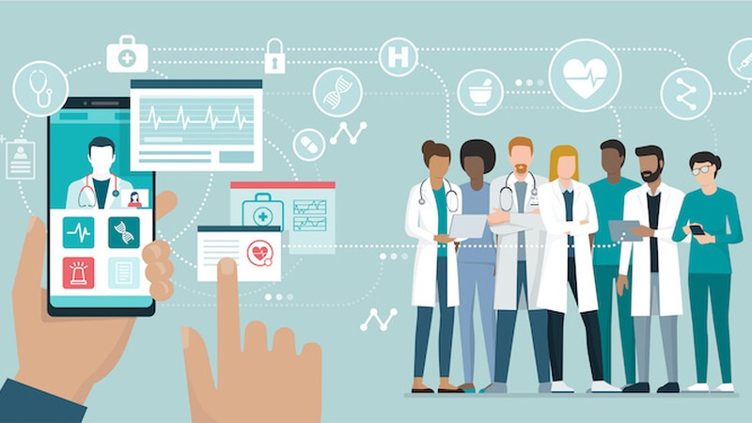
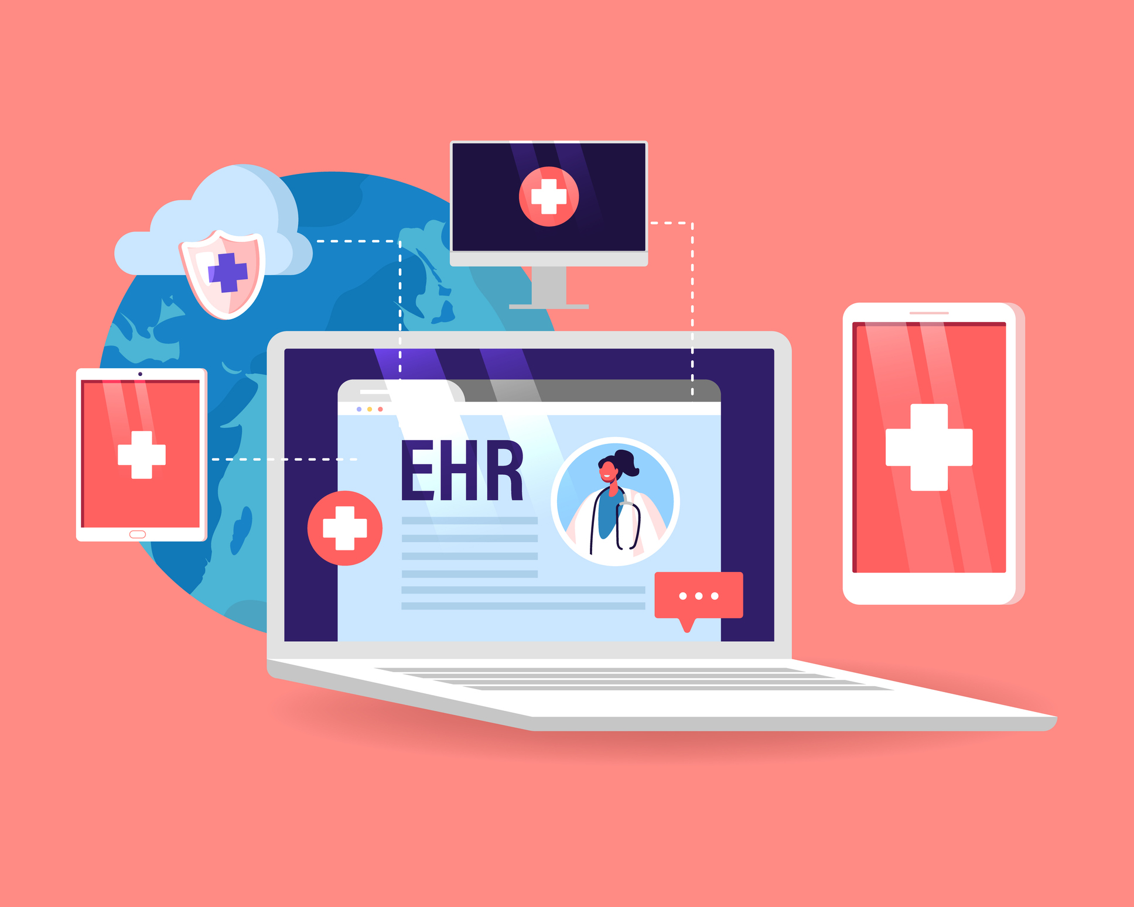
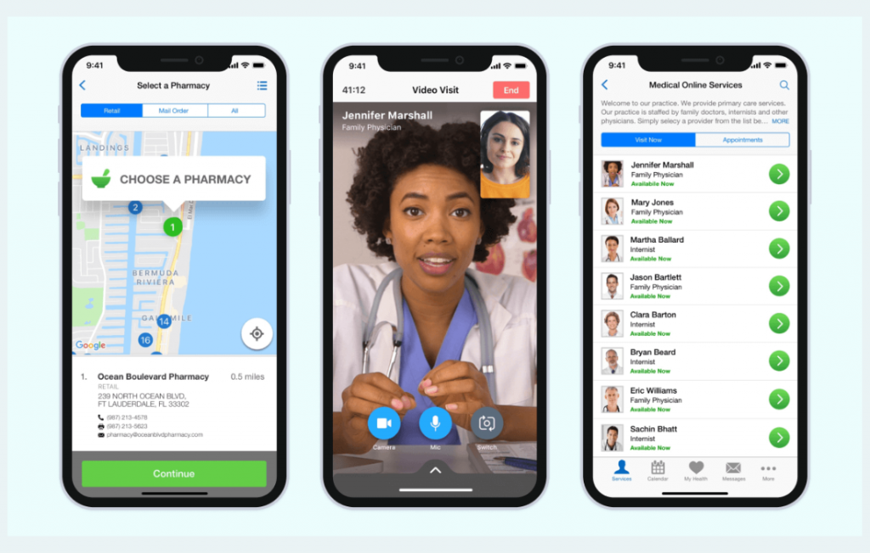
Core Components of Health Informatics
Electronic Health Records: Centralized, accessible patient information.
Telemedicine: Remote diagnosis and treatment via digital platforms.
Mobile Health (mHealth): Apps for self-monitoring, alerts, and chronic disease management.
Data Analytics: Predictive modeling, population health insights.

Slide 6

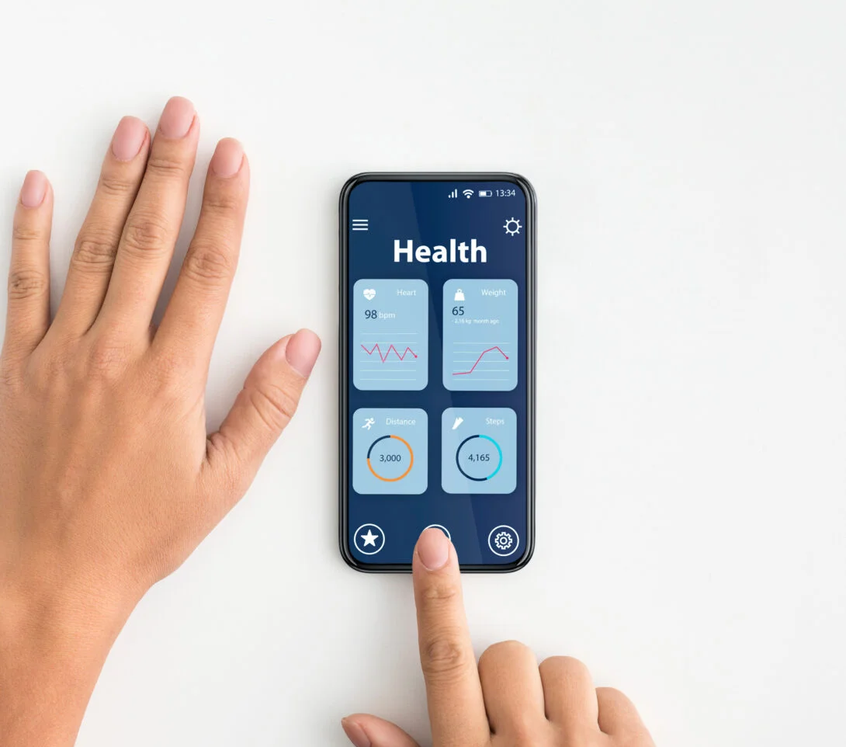
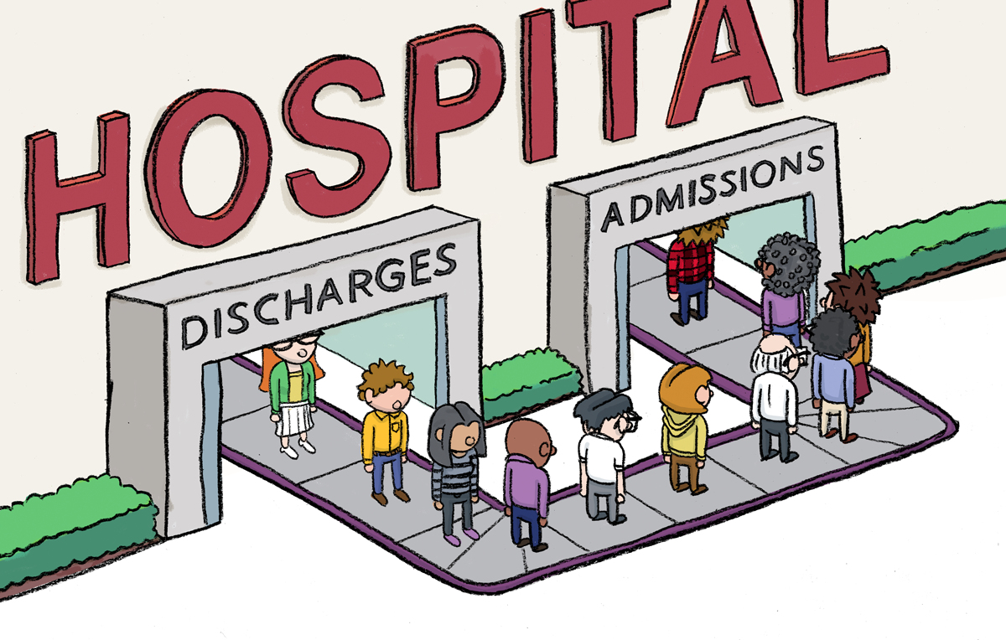
Impact of Health Informatics in Today World
Reduction in Redundancies: Minimizes unnecessary testing and duplicate procedures through centralized records.
Hospital Readmission Prevention: Ongoing remote monitoring and alerts reduce acute events and emergency revisits.
Cost-Efficient Resource Allocation: Allows better management of staff schedules, equipment use, and bed assignments.
Preventive Care Emphasis: Enables proactive outreach and early detection, avoiding costly late-stage treatments.

Slide 7
Positive Outcomes of Informatics Integration
Real-Time Access to Data: Health professionals can access complete patient histories instantly, improving the timeliness and accuracy of diagnoses.
Streamlined Communication: Facilitates seamless coordination among primary care providers, specialists, and labs.
Clinical Decision Support: Informatics systems offer evidence-based tools that aid in diagnosing and managing diseases more effectively.
Patient Engagement: mHealth apps and portals allow patients to track their health, receive reminders, and communicate with providers, increasing adherence and satisfaction.

Slide 8



Barriers and Implementation Challenges
High Initial Investment: Includes software, hardware, and training costs that can burden smaller clinics.
Data Privacy Concerns: Patient information must be protected against cyber threats, requiring advanced security systems.
Resistance to Adoption: Some healthcare workers may be reluctant to shift from familiar paper-based systems to digital tools.
Need for Training and Support: Success depends on continuous education and accessible technical support for all users.

Slide 9
Policy and Practical Recommendations
Expand Digital Infrastructure: Prioritize broadband and IT development in rural and underserved areas.
Government Incentives: Offer subsidies, tax benefits, and grants to encourage adoption among providers.
Standardized Training Modules: Implement nationwide training for healthcare professionals on digital health tools.
Policy Alignment: Develop legal frameworks that keep pace with emerging technologies while safeguarding patient rights.

Slide 10



Real-World Case Examples/Other Research
Kaiser Permanente: Integrated informatics system reduced hospital readmissions by 26% through coordinated care and analytics.
VA Telehealth Services: Improved rural access to specialists and reduced travel-related costs for patients.
Epic Systems in Large Hospitals: Enabled shared records across departments, improving response time in emergencies.

Slide 11
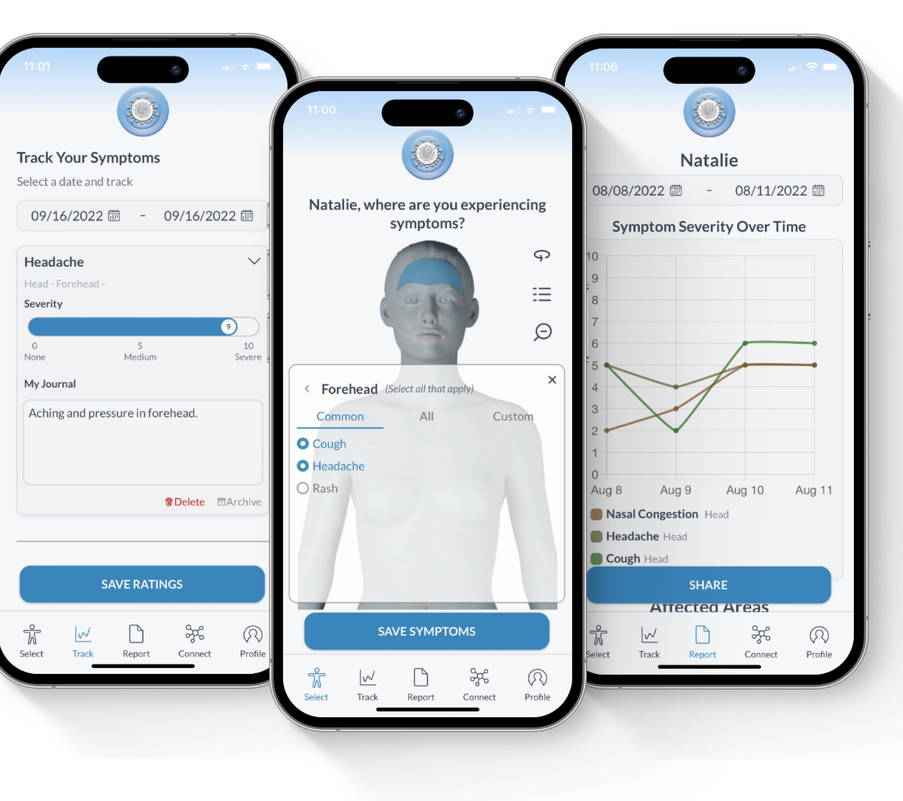
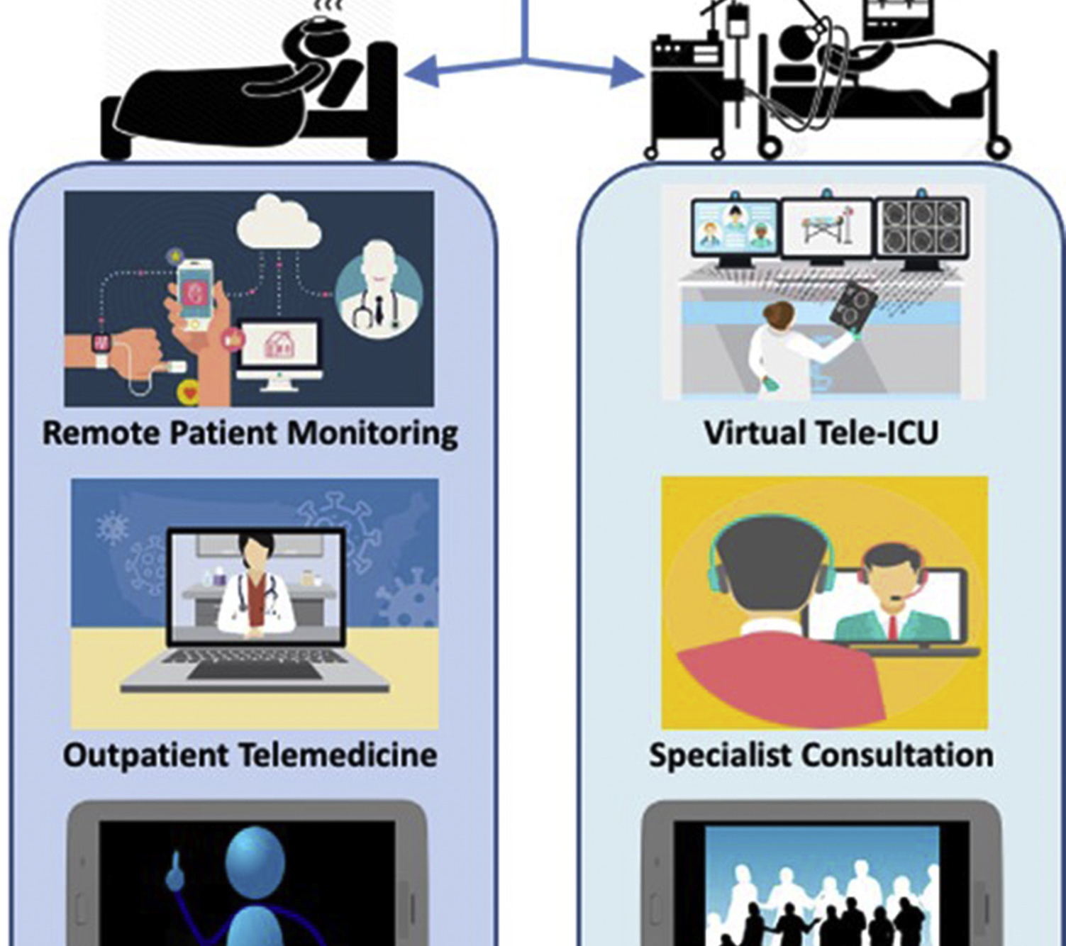
Health Informatics in Pandemic Response
Enabled real-time contact tracing and symptom tracking through mobile apps.
Aggregated data to monitor ICU occupancy and resource allocation.
Facilitated widespread adoption of teleconsultations, ensuring continuity of care during lockdowns.

Slide 12
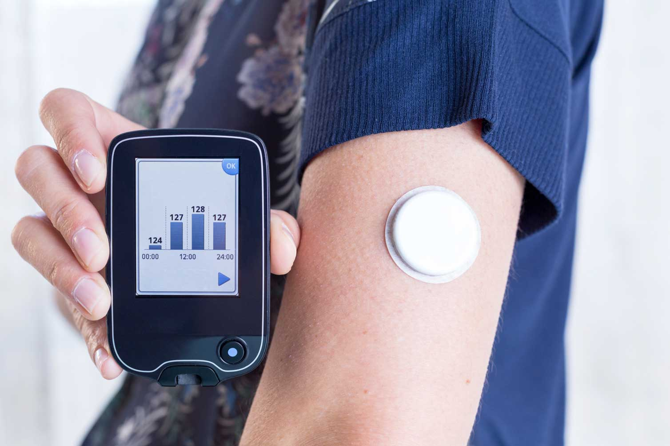
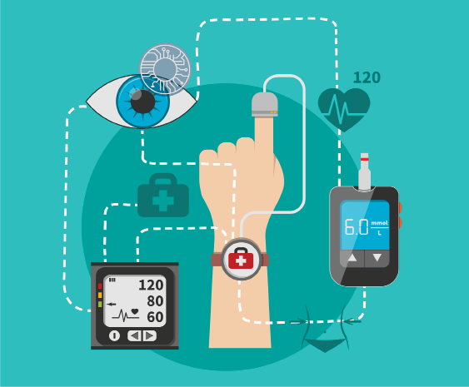
Future Directions in Health Informatics/Opportunity for research in this new horizon.
AI and Machine Learning: Personalized medicine through predictive analytics.
Blockchain for EHRs: Ensures data integrity, privacy, and secure sharing.
Wearable Tech Integration: Continuous monitoring of vitals and activity for chronic condition management.

Slide 13

Conclusion
Health informatics serves as a catalyst for more effective, safer, and cost-efficient healthcare delivery.
Strategic implementation enhances provider workflows and patient experiences alike.
Collaborative efforts from policymakers, healthcare workers, and technologists are essential to drive sustained impact.

Slide 14
Literature Review
Study | Focus Area | Key Findings
Zhang et al. (2013) | IoT for COPD Management | - Increased compliance- Better symptom control- Reduced ER visits
Black et al. (2011) | eHealth Safety Review | - Improved patient safety- Efficiency in clinical operations- Better care coordination
Ruyobeza et al. (2022) | Remote Monitoring Barriers | - Need for digital infrastructure- Importance of user training and trust
Frontiers in Public Health (2022) | Digital Health Cost Review | - Significant cost-saving potential- Long-term healthcare optimization
JAMIA Review | Health IT Outcomes | - Enhances patient safety- Boosts provider decision-making accuracy

Slide 15
REFERENCES
1.Zhang, J., Song, Y.-L., & Bai, C.-X. (2013). MIOTIC study: A prospective, multicenter, randomized study to evaluate the long-term efficacy of mobile phone-based Internet of Things in the management of patients with stable COPD (RCT). International Journal of Chronic Obstructive Pulmonary Disease, 8, 433–438. https://doi.org/10.xxxx
2. Black, A. D., Car, J., Pagliari, C., Anandan, C., & Creswell, K., et al. (2011). The impact of eHealth on the quality and safety of health care: A systematic overview. PLoS Medicine, 8(1), e1000387. https://doi.org/10.xxxx
3.Ruyobeza, B., Grobbelaar, S. S., & Botha, A. (2022). Hurdles to developing and scaling remote patients' health management tools and systems: A scoping review. Systematic Reviews, 11(1), 179. https://doi.org/10.xxxx
4.Gentili, A., Failla, G., Melnyk, A., Puleo, V., Tanna, G. L. D., Ricciardi, W., & Cascini, F. (2022). The cost-effectiveness of digital health interventions: A systematic review of the literature. Frontiers in Public Health, 10, Article 787135. https://doi.org/10.3389/fpubh.2022.787135
5. Brenner, S. K., Kaushal, R., Grinspun, Z., Joyce, C., Kim, I., Allard, R. J., Delgado, D., & Abramson, E. L. (2016). Effects of health information technology on patient outcomes: A systematic review. Journal of the American Medical Informatics Association, 23(5), 1016–1036. https://doi.org/10.1093/jamia/ocv138
6. Digital health innovations. (2024). Retrieved from https://www.sciencedirect.com/science/article/pii/S2949953424000092
7.Rachakonda, L. (2021). IoMT-Based Accurate Stress Monitoring for Smart Healthcare (Doctoral dissertation, University of North Texas). Retrieved from https://digital.library.unt.edu/ark:/67531/metadc1808404/
8. Alahmadi, A., Khan, H. A., Shafiq, G., Ahmed, M. A., Javed, M. A., Khan, M. Z., Alsisi, R. H., & Alahmadi, A. H. (2023). A privacy-preserved IoMT-based mental stress detection framework with federated learning. The Journal of Supercomputing. Advance online publication. https://doi.org/10.1007/s11227-023-05847-3

Slide 16


